Slide 1
Buy and Sell App
Main Pages

Slide 2
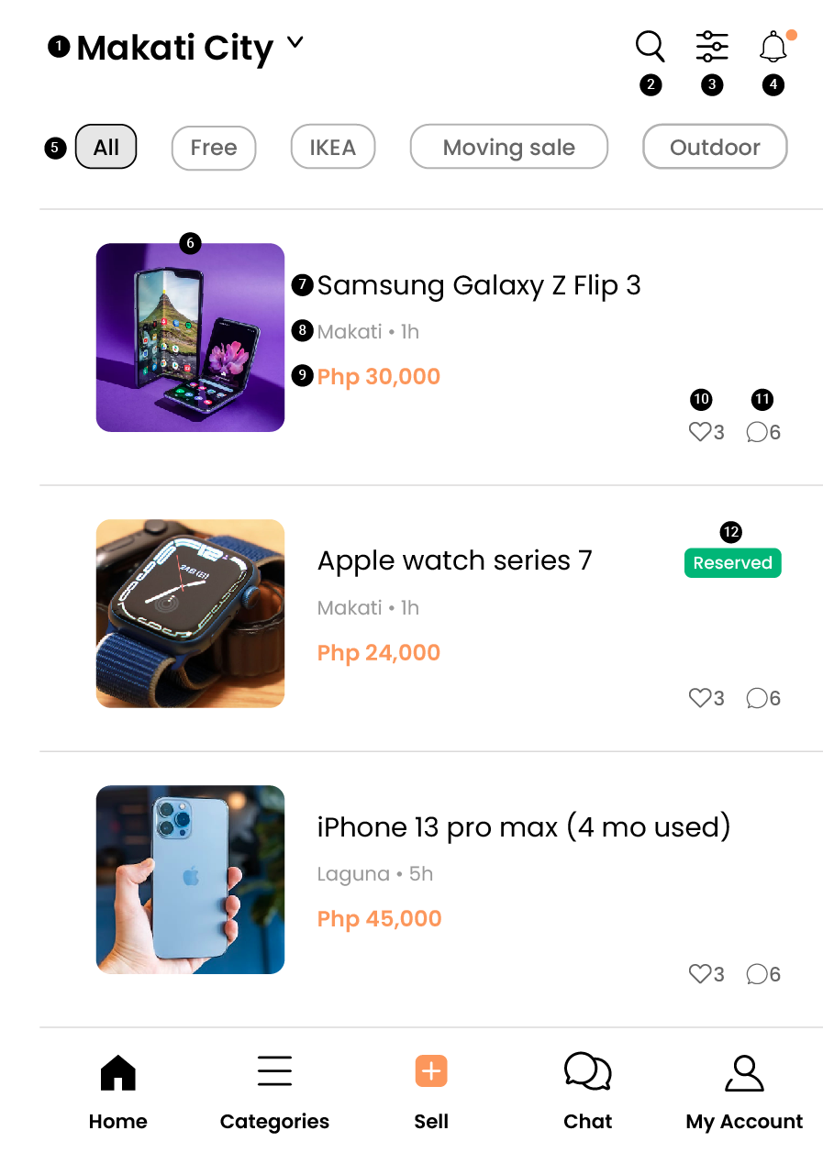
HOME PAGE
USER LOCATION
SEARCH ITEMS / PRODUCTS
CUSTOMIZE FEED
NOTIFICATIONS
CATEGORIES SECTION
PRODUCT IMAGE
PRODUCT NAME
PRODUCT LOCATION
PRODUCT PRICE
LIKES / FAVORITES
CHAT
RESERVED BADGE

Slide 3
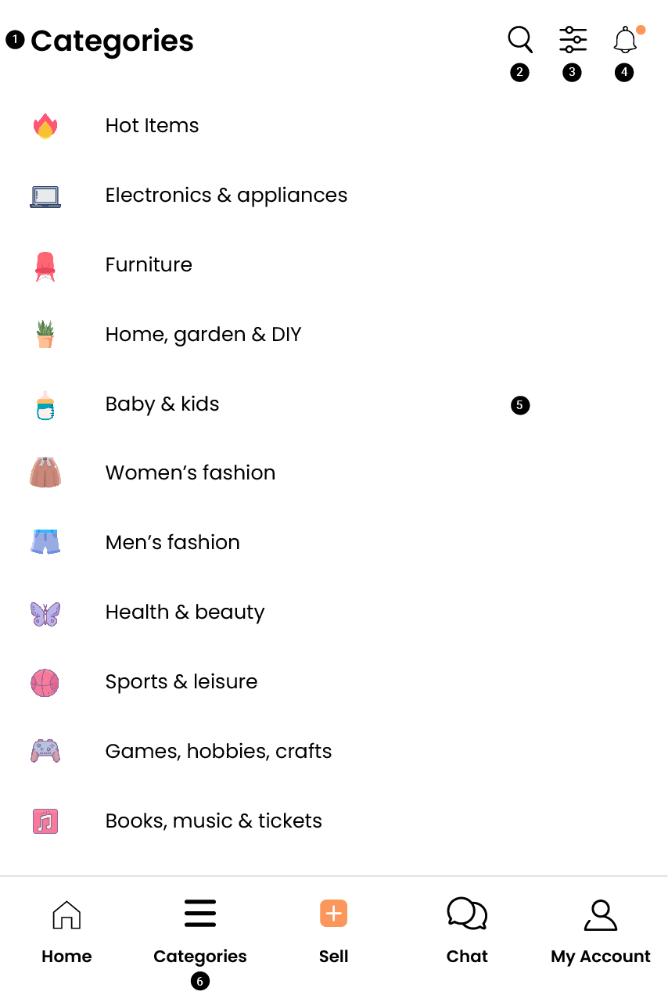
CATEGORIES
PAGE TITLE (CATEGORIES)
SEARCH ITEMS / PRODUCTS
CUSTOMIZE FEED
NOTIFICATIONS
CATEGORY LIST
CATEGORIES TAB

Slide 4
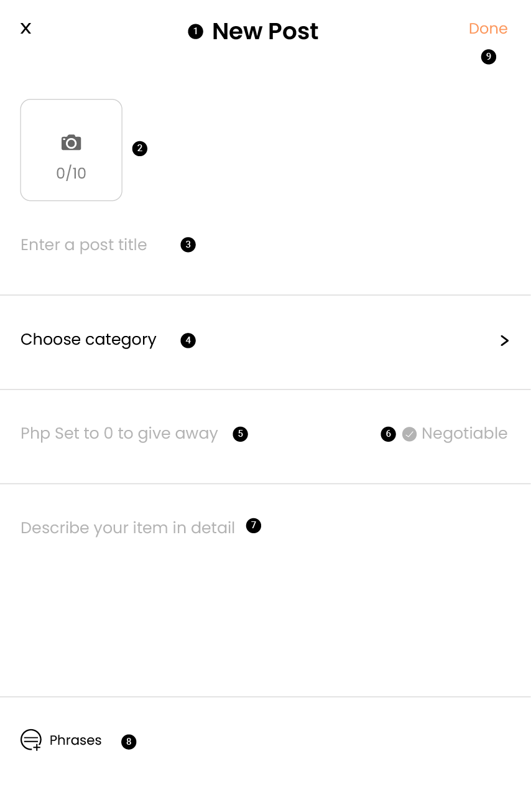
SELL
SELL PAGE
PRODUCT / ITEM PHOTO (MAX 10 IMAGES)
PRODUCT / ITEM TITLE
PRODUCT / ITEM CATEGORY
PRODUCT / ITEM PRICE
NEGOTIABLE PRICE OPTION
PRODUCT / ITEM DETAILED DESCRIPTION
SAVED FREQUENTLY USED PHRASES
POST ITEM

Slide 5
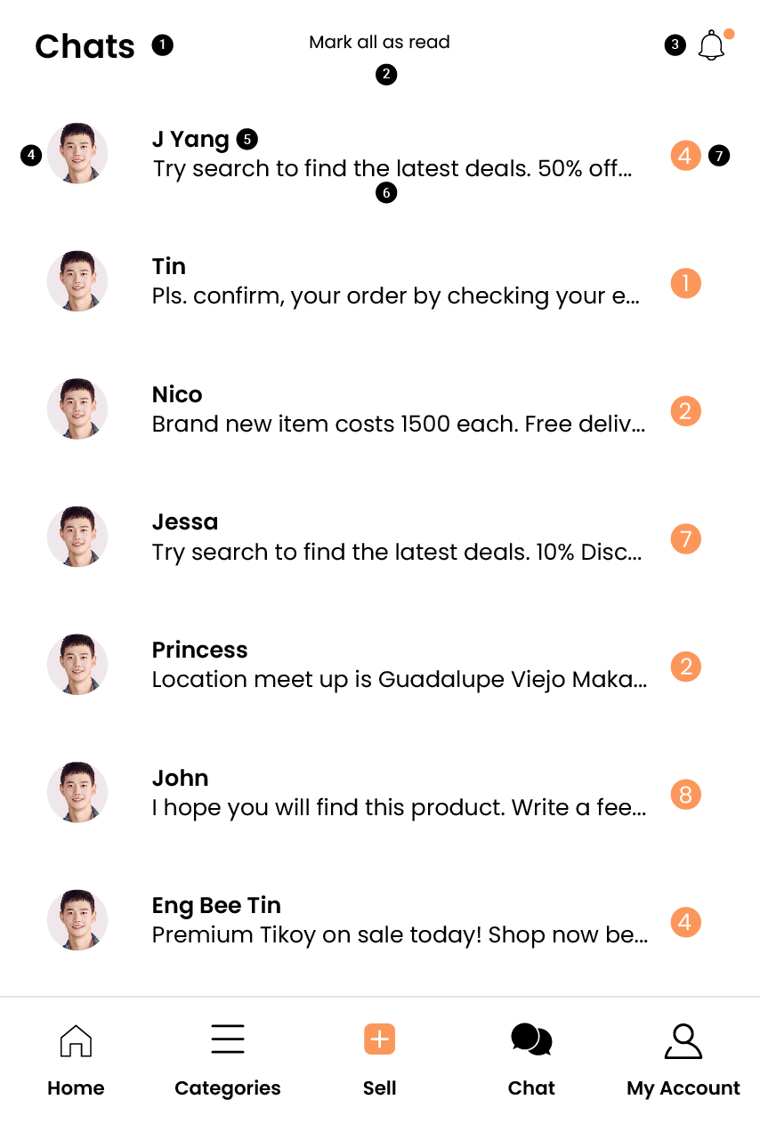
CHAT
PAGE TITLE (CHATS)
MARK ALL AS READ
NOTIFICATIONS
USER AVATAR / PHOTO
USER NAME
MESSAGE EXCERPT
NUMBER OF UNREAD MESSAGES

Slide 6
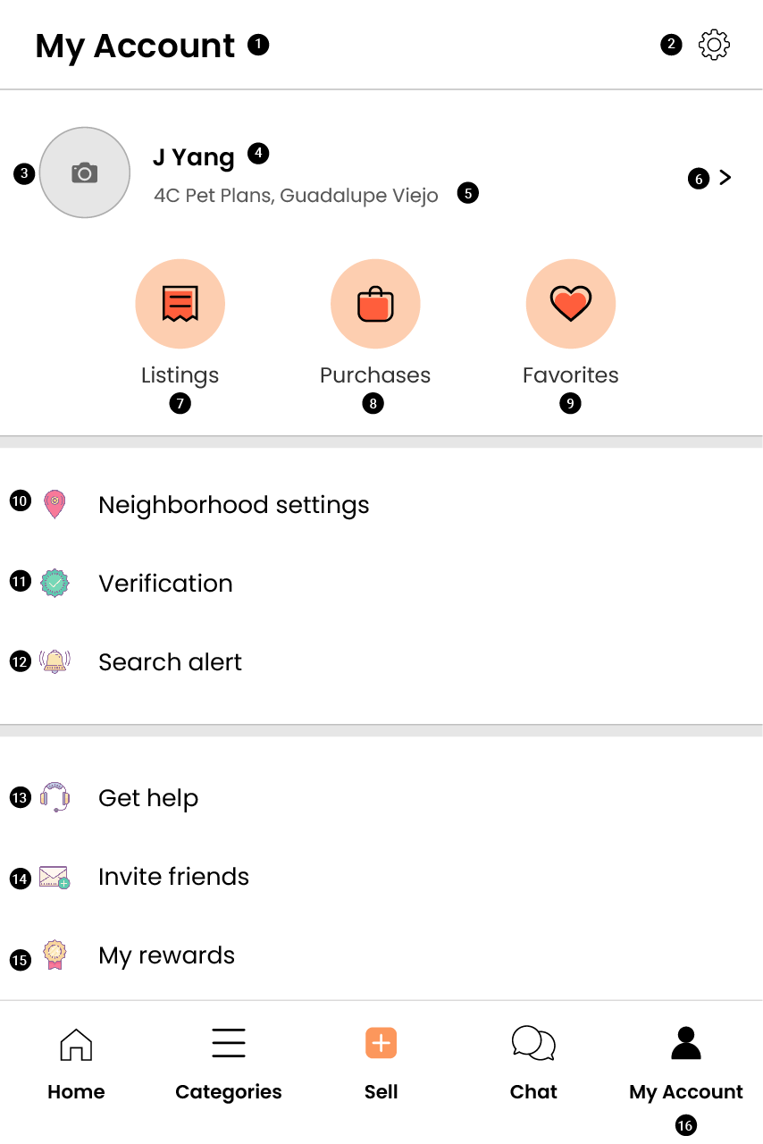
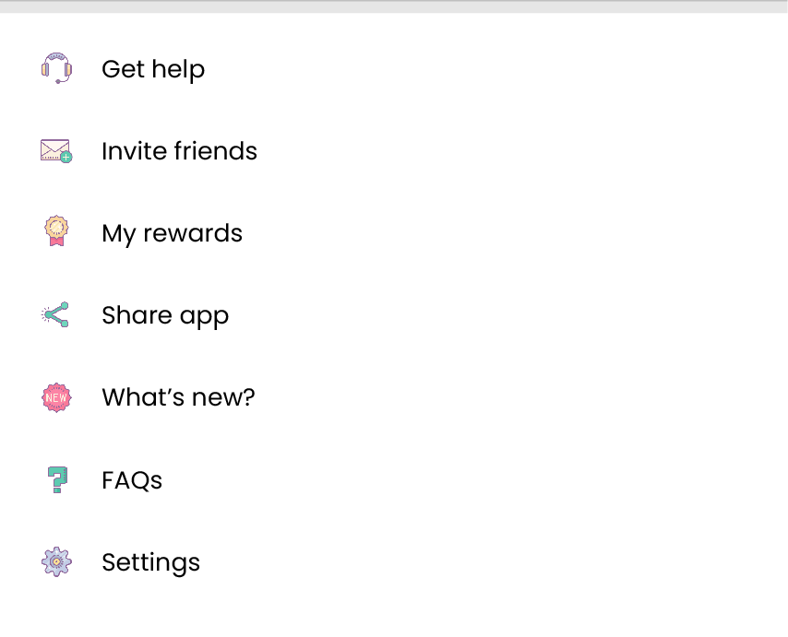
MY ACCOUNT
PAGE TITLE (MY ACCOUNT)
ACCOUNT SETTINGS
ACCOUNT USER IMAGE
USER NAME
USER ADDRESS / LOCATION
USER PROFILE
LISTINGS
PURCHASES
FAVORITES
NEIGHBORHOOD SETTINGS
VERIFICATION
SEARCH ALERT
HELP
INVITE FRIENDS
MY ACCOUNT

Slide 7
Buy and Sell App
Sub Pages

Slide 8
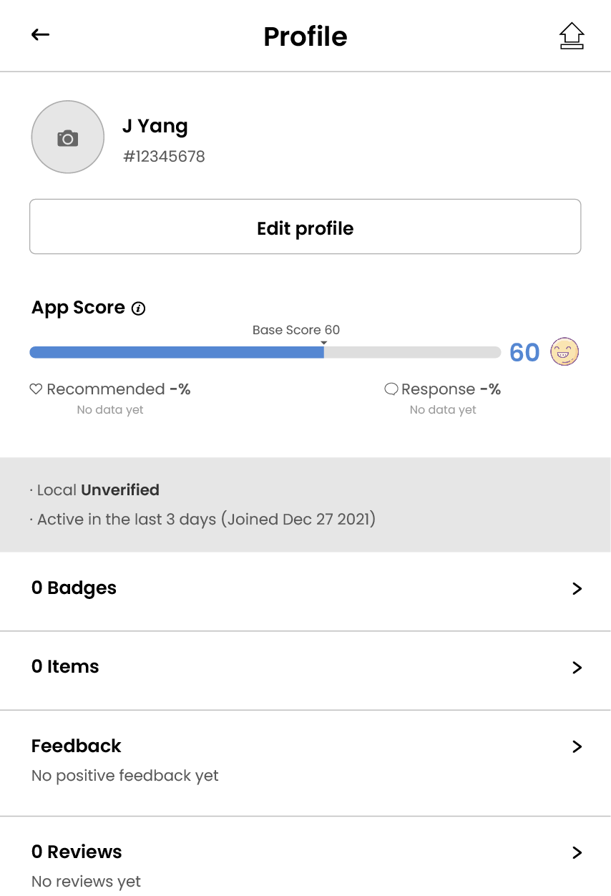
PROFILE

Slide 9
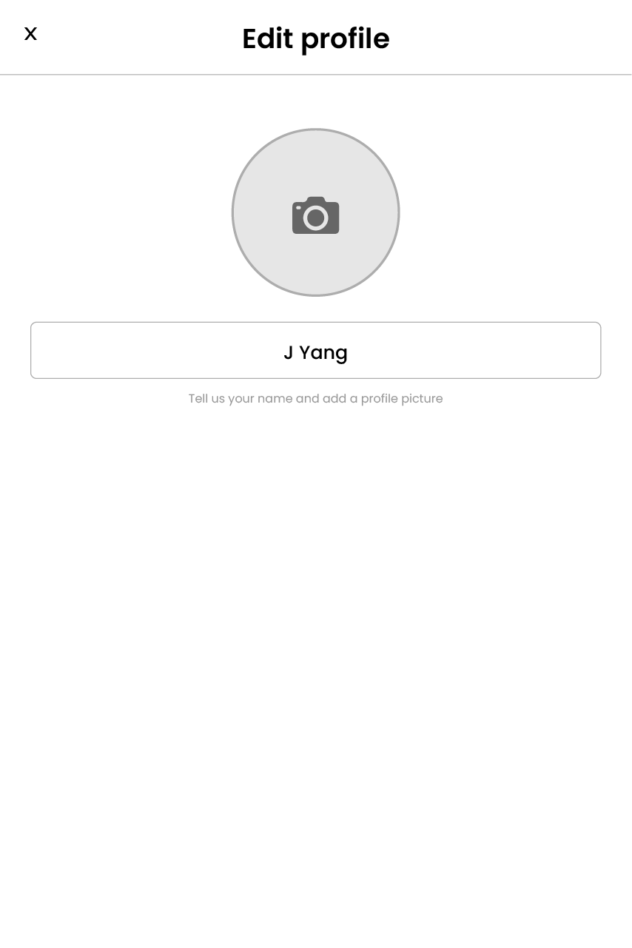
EDIT PROFILE

Slide 10
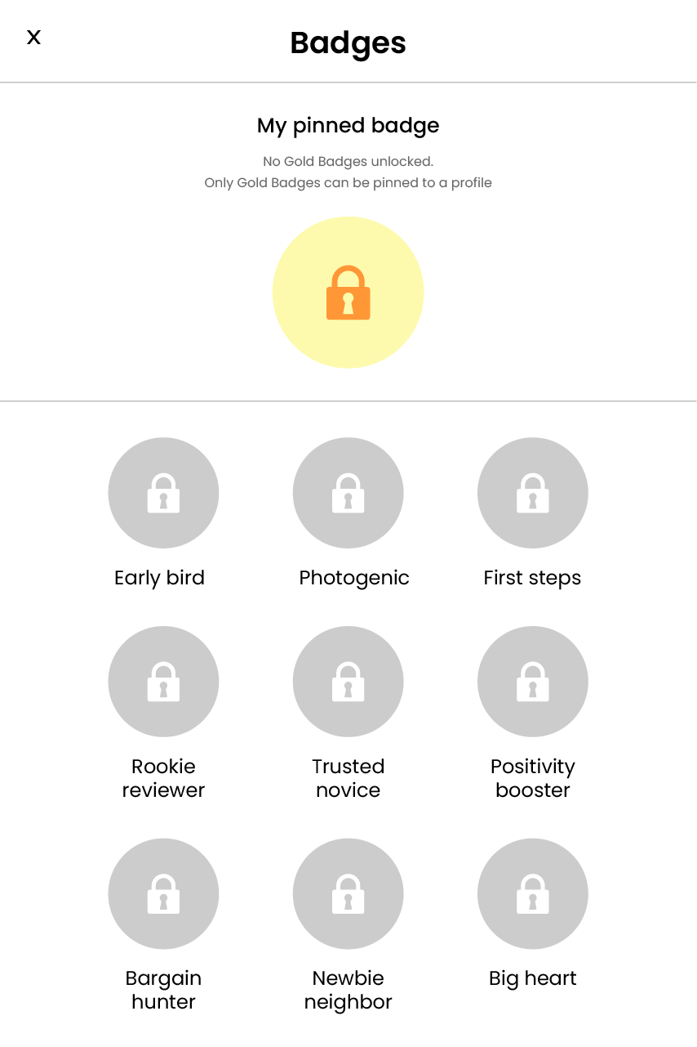
EDIT PROFILE

Slide 11
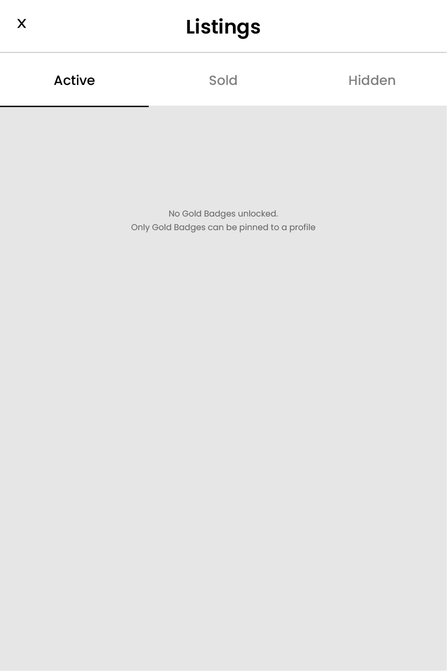
ITEMS

Slide 12
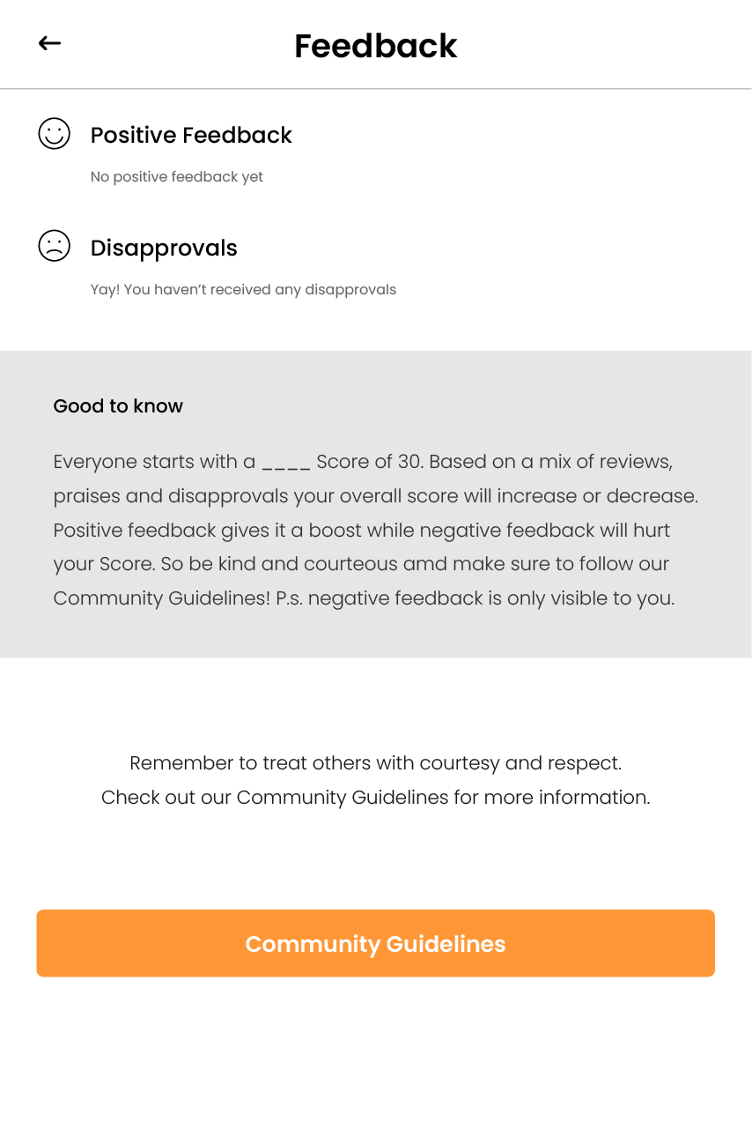
FEEDBACK

Slide 13

REVIEWS

Slide 14
Level system
Normal user

Slide 15
Payment system
Sub Pages

